Slide 1
Intro to Jupyter
ie – why you should care, some hands on experience, and some jupyter-based evangelism

Slide 2
Full Transparency: I think we should all use Jupyter in our daily lives
But that involves CHANGE

Slide 3

Change management is a thing

Slide 4
There are pieces and steps required for change to happen
Awareness of the need for change
Desire to support the change
Knowledge of how to change
Ability to demonstrate new skills and behaviors
Reinforcement to make the change stick

Slide 5
What do you do when you give code you wrote to someone else?
SELECT last_name, salary + NVL(commission_pct, 0),
job_id, e.department_id
FROM employees e, departments d
WHERE e.department_id = d.department_id
AND salary + NVL(commission_pct,0) >
(SELECT salary + NVL(commission_pct,0)
FROM employees
WHERE last_name = 'Pataballa');
SELECT last_name,
salary + NVL(commission_pct, 0),
job_id,
e.department_id
FROM employees e,
departments d
WHERE e.department_id = d.department_id
AND salary + NVL(commission_pct, 0) >
(SELECT salary + NVL(commission_pct,0)
FROM employees
WHERE last_name = 'Pataballa')
;

Slide 6
Commenting
SELECT last_name, salary + NVL(commission_pct, 0),
job_id, e.department_id
/* Select all employees whose compensation is
greater than that of Pataballa.*/
FROM employees e, departments d
/*The DEPARTMENTS table is used to get the department name.*/
WHERE e.department_id = d.department_id
AND salary + NVL(commission_pct,0) > /* Subquery: */
(SELECT salary + NVL(commission_pct,0)
/* total compensation is salary + commission_pct */
FROM employees
WHERE last_name = 'Pataballa');
SELECT last_name, -- select the name
salary + NVL(commission_pct, 0),-- total compensation
job_id, -- job
e.department_id -- and department
FROM employees e, -- of all employees
departments d
WHERE e.department_id = d.department_id
AND salary + NVL(commission_pct, 0) > -- whose compensation
-- is greater than
(SELECT salary + NVL(commission_pct,0) -- the compensation
FROM employees
WHERE last_name = 'Pataballa') -- of Pataballa.
;

Slide 7
Commenting – with color!
SELECT last_name, salary + NVL(commission_pct, 0),
job_id, e.department_id
/* Select all employees whose compensation is
greater than that of Pataballa.*/
FROM employees e, departments d
/*The DEPARTMENTS table is used to get the department name.*/
WHERE e.department_id = d.department_id
AND salary + NVL(commission_pct,0) > /* Subquery: */
(SELECT salary + NVL(commission_pct,0)
/* total compensation is salary + commission_pct */
FROM employees
WHERE last_name = 'Pataballa');
SELECT last_name, -- select the name
salary + NVL(commission_pct, 0),-- total compensation
job_id, -- job
e.department_id -- and department
FROM employees e, -- of all employees
departments d
WHERE e.department_id = d.department_id
AND salary + NVL(commission_pct, 0) > -- whose compensation
-- is greater than
(SELECT salary + NVL(commission_pct,0) -- the compensation
FROM employees
WHERE last_name = 'Pataballa') -- of Pataballa.
;

Slide 8
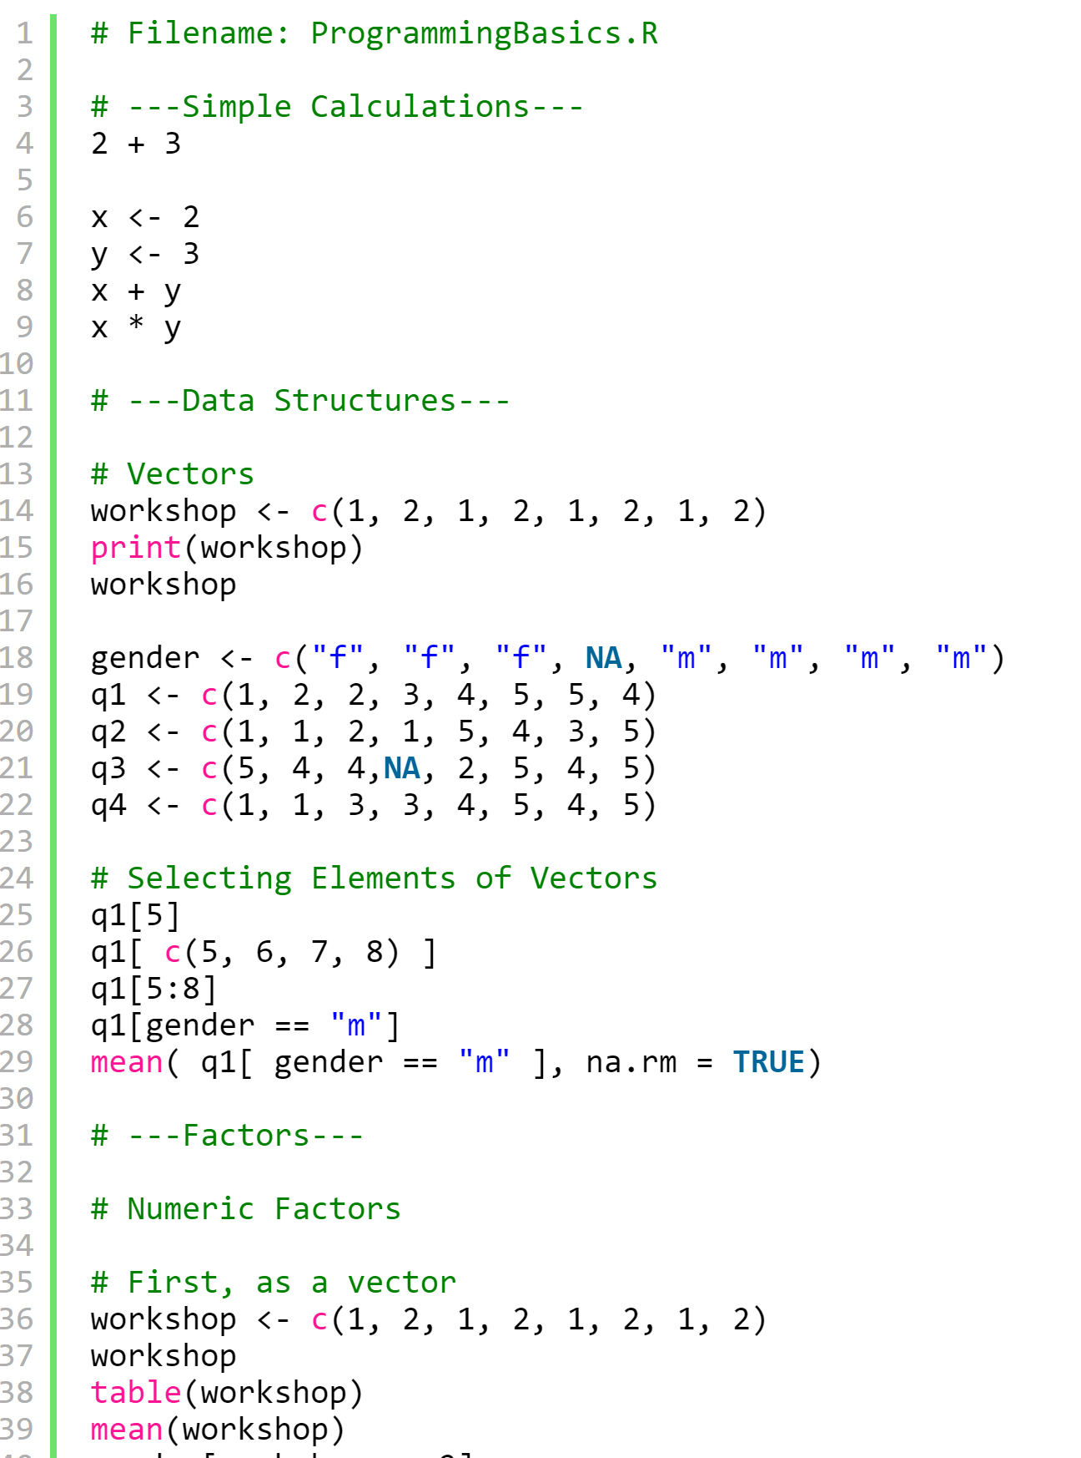
What about languages you don’t know?
Table 9: SAS Code for Logistic Regression Models with Horseshoe
Crab Data in Table 4.3
------------------------------------------------------------------------
data crab;
input color spine width satell weight;
if satell>0 then y=1; if satell=0 then y=0;
if color=4 then light=0; if color < 4 then light=1;
datalines;
2 3 28.3 8 3.05
4 3 22.5 0 1.55
...
2 2 24.5 0 2.00
;
proc genmod descending; class color;
model y = width color / dist=bin link=logit lrci type3 obstats;
contrast ’a-d’ color 1 0 0 -1;
proc genmod descending;
model y = width color / dist=bin link=logit;
proc genmod descending;
model y = width light / dist=bin link=logit;
proc genmod descending; class color spine;
model y = width weight color spine / dist=bin link=logit type3;
ods graphics on;
ods html;
proc logistic descending plots=all;
class color spine / param=ref;
model y = width weight color spine / selection=backward lackfit;
proc gam plots=components(clm commonaxes); * generalized additive model;
model y (event=’1’) = spline(width) / dist=binary; * smooth data;
run;
ods html close;
ods graphics off;
run;

Slide 9

How do we tell the story of our ETL and analysis?

Slide 10

Jupyter (pronounced like the planet)
Project Jupyter was born out of the IPython project as the project evolved to become a notebook that could support multiple languages - hence its historical name as the IPython notebook. The name Jupyter is an indirect acronyum of the three core languages it was designed for: JUlia, PYThon, and R and is inspired by the planet Jupiter.
But has since expanded to many more languages.

Slide 11
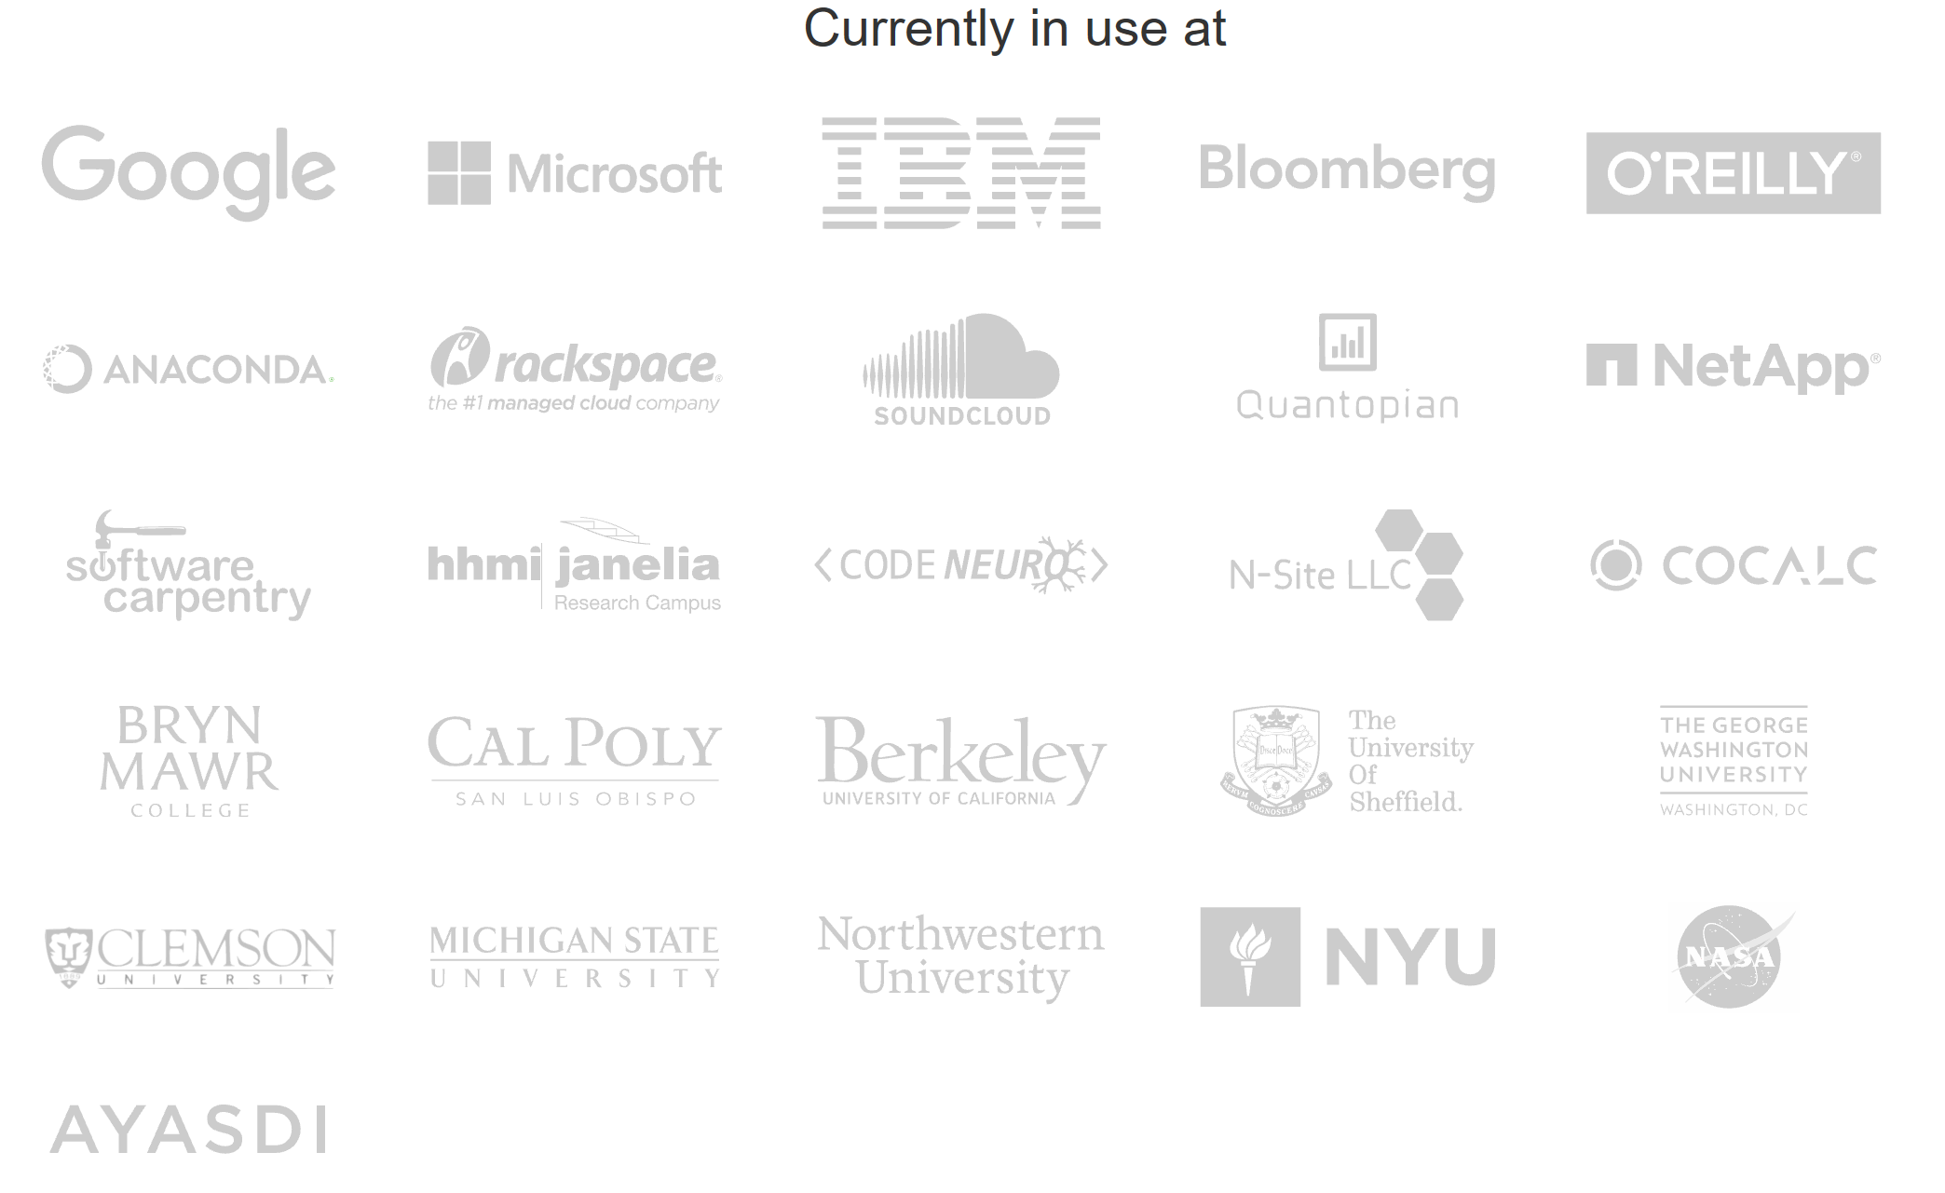

Slide 12
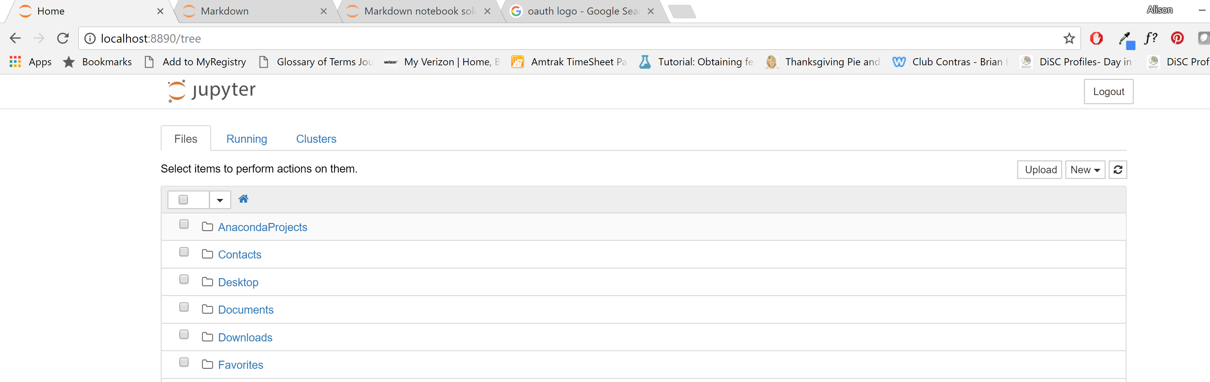
Opening Up Jupyter – a Tour
The "Files" tab is where all your files are kept, the "Running" tab keeps track of all your processes and the third tab, "Clusters", is provided by IPython parallel, IPython's parallel computing framework. It allows you to control many individual engines, which are an extended version of the IPython kernel.
Then you'll see the application opening in the web browser on the following address: http://localhost:8888.

Slide 13
Welcome to the Jupyter Toolbar
This is your save button. You can click this button to save your notebook at any time, though keep in mind that Jupyter Notebooks automatically save your progress very frequently.

Slide 14
Welcome to the Jupyter Toolbar
This is the new cell button. You can click this button any time you want a new cell in your Jupyter Notebook.

Slide 15
Welcome to the Jupyter Toolbar
This is the cut cell button. If you click this button, the cell you currently have selected will be deleted from your Notebook.

Slide 16
Welcome to the Jupyter Toolbar
This is the copy cell button. If you click this button, the currently selected cell will be duplicated and stored in your clipboard.

Slide 17
Welcome to the Jupyter Toolbar
This is the paste button. It allows you to paste the duplicated cell from your clipboard into your notebook.

Slide 18
Welcome to the Jupyter Toolbar
These buttons allow you to move the location of a selected cell within a Notebook. Simply select the cell you wish to move and click either the up or down button until the cell is in the location you want it to be.

Slide 19
Welcome to the Jupyter Toolbar
This button will "run" your cell, meaning that it will interpret your input and render the output in a way that depends on what kind of cell you're using.

Slide 20
Welcome to the Jupyter Toolbar
This is the stop button. Clicking this button will stop your cell from continuing to run. This tool can be useful if you are trying to execute more complicated code, which can sometimes take a while, and you want to edit the cell before waiting for it to finish rendering.

Slide 21
Welcome to the Jupyter Toolbar
This is the restart kernel button. See your kernel documentation for more information.

Slide 22
Welcome to the Jupyter Toolbar
This is a drop down menu which allows you to tell your Notebook how you want it to interpret any given cell.

Slide 23
Markdown Tutorial & Exercise

Slide 24
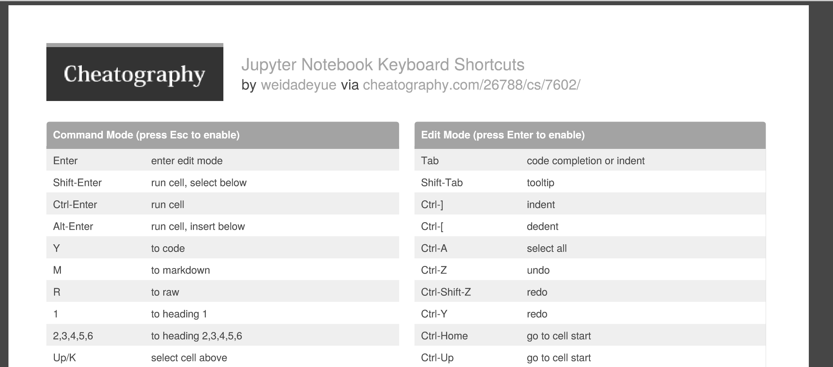
There are also many shortcuts

Slide 25
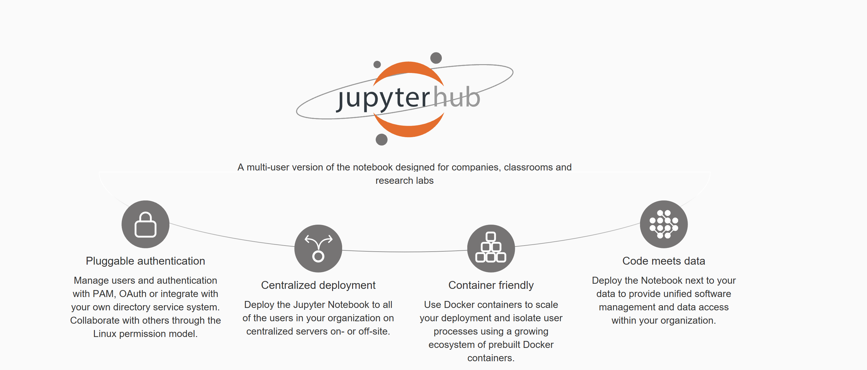
Jupyter Hub

Slide 26
Jupyter is pervasive
It’s being used to publish tutorials on the web
As companions to books
And even in blogs
And adoption rates are increasing

Slide 27
